Slide 1

Analysis of Covid-19 data
Lungelo Mthiyane

Slide 2



Table of Contents
Objective of Analysis
About the data
Methodology of Analysis
Results and Insights
Conclusion

Slide 3




Objectives
In this analysis I had to use global Covid-19 data and use the data to identify the countries with the highest number of cases and to also identify any trends in the cases across the years 2020, 2021 and 2022.

Slide 4

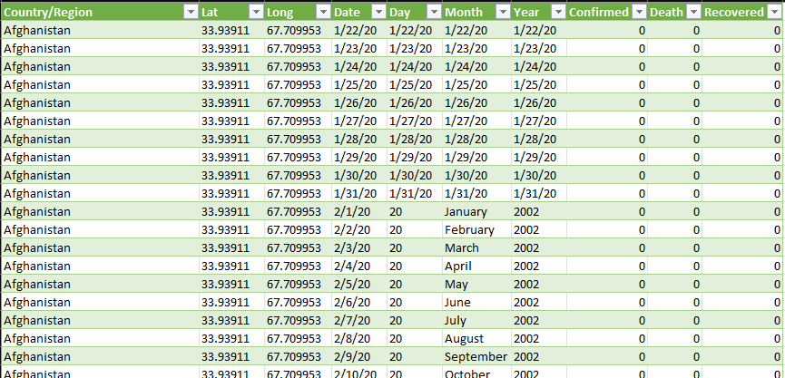
About the data
The data was acquired from the John Hopkins University in the USA
The data is a time series data, and it is updated on a regular basis.
The dataset contains data on confirmed cases, deaths and recoveries from the years 2020, 2021 and 2022

Slide 5
Methodology
The entire analysis was executed on Microsoft Excel
Power Query was used to clean and merge the data
Pivot tables were used for the calculations
Pivot Charts were used to visualize the insights gained

Slide 6
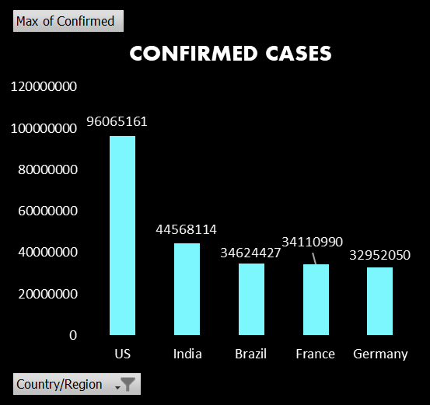
Confirmed Cases
It was apparent that the USA had the most cases and ranked first in the country with the most confirmed cases.
The data was restricted to actual confirmed cases as we can’t account for people who did not test.
The total number of confirmed cases at the time of the analysis was 602,796,643

Slide 7
Confirmed Cases By Year
There was a steady growth in cases with each year which proved that either more people were testing and /or the fact that we were still battling to deal with the virus.
From 2020 – 2022 the confirmed cases increased by a rate of 203.5%

Slide 8
Confirmed Cases
It was apparent that the USA had the most cases and ranked first in the country with the most confirmed cases.
The data was restricted to actual confirmed cases as we can’t account for people who did not test.
The total number of confirmed cases at the time of the analysis was 602,796,643

Slide 9
Deaths
With America having the most confirmed cases, it was not surprise to find that most covid deaths came from America.
4 countries in the top 5 confirmed cases made the top 5 for covid deaths with only Germany not making the top 5

Slide 10
Deaths By Year
There was an increase in deaths from 2020 to 2021 but in 2022 the number of deaths went down as the countries started responding to the pandemic

Slide 11

Conclusion
It is evident that Covid-19 remains a problem for the world but the decreasing rate of deaths shows that the world leaders are responding to the threat.
We are hopeful that all the efforts from the WHO will continue to help the world combat the virus

Slide 12


Thank You
Lungelo Mthiyane
mthiyanelungelo@gmail.com

